Slide 1
142ND Military Personnel Flight
Headquarters U.S. Air Force
I n t e g r i t y - S e r v i c e - E x c e l l e n c e
How to request Military Records via milConnect
142nd FSS
21 OCT 2020
1

Slide 2
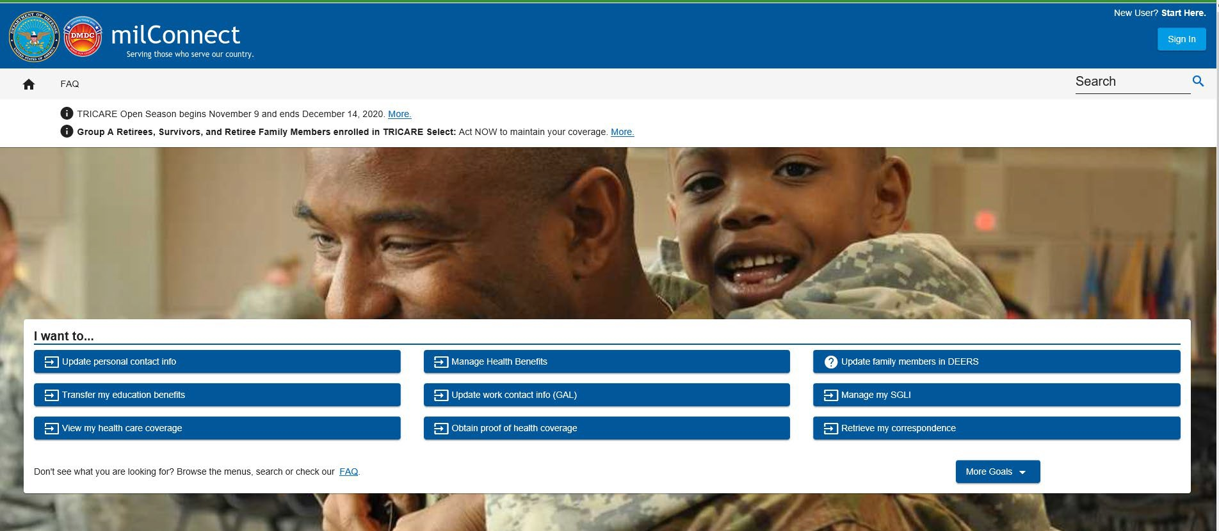
milConnect
Ensure you have created a DS login
* Username and Password
Navigate to https://milconnect.dmdc.osd.mil/milconnect/ in your browser
Click “Sign In” in the upper right hand corner
10/21/2020
I n t e g r i t y - S e r v i c e - E x c e l l e n c e
2

Slide 3
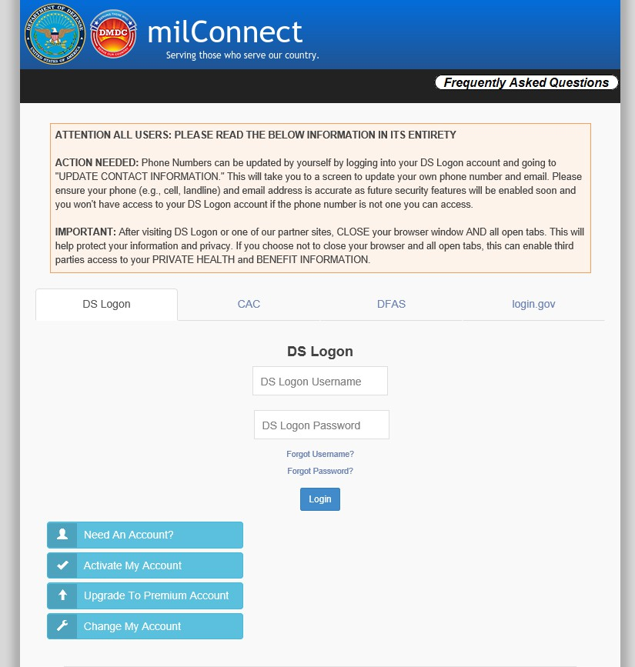
milConnect
Input DS Login username and password
If you need assistance with your account look through these options
I n t e g r i t y - S e r v i c e - E x c e l l e n c e

Slide 4
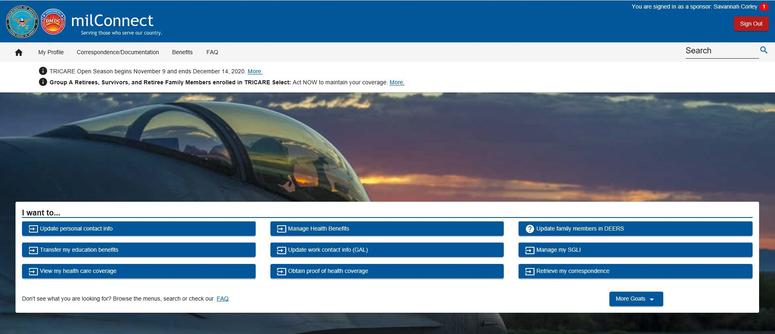
milConnect
Once redirected to home screen after logon please click on “Correspondence/Documentation”
I n t e g r i t y - S e r v i c e - E x c e l l e n c e
4

Slide 5
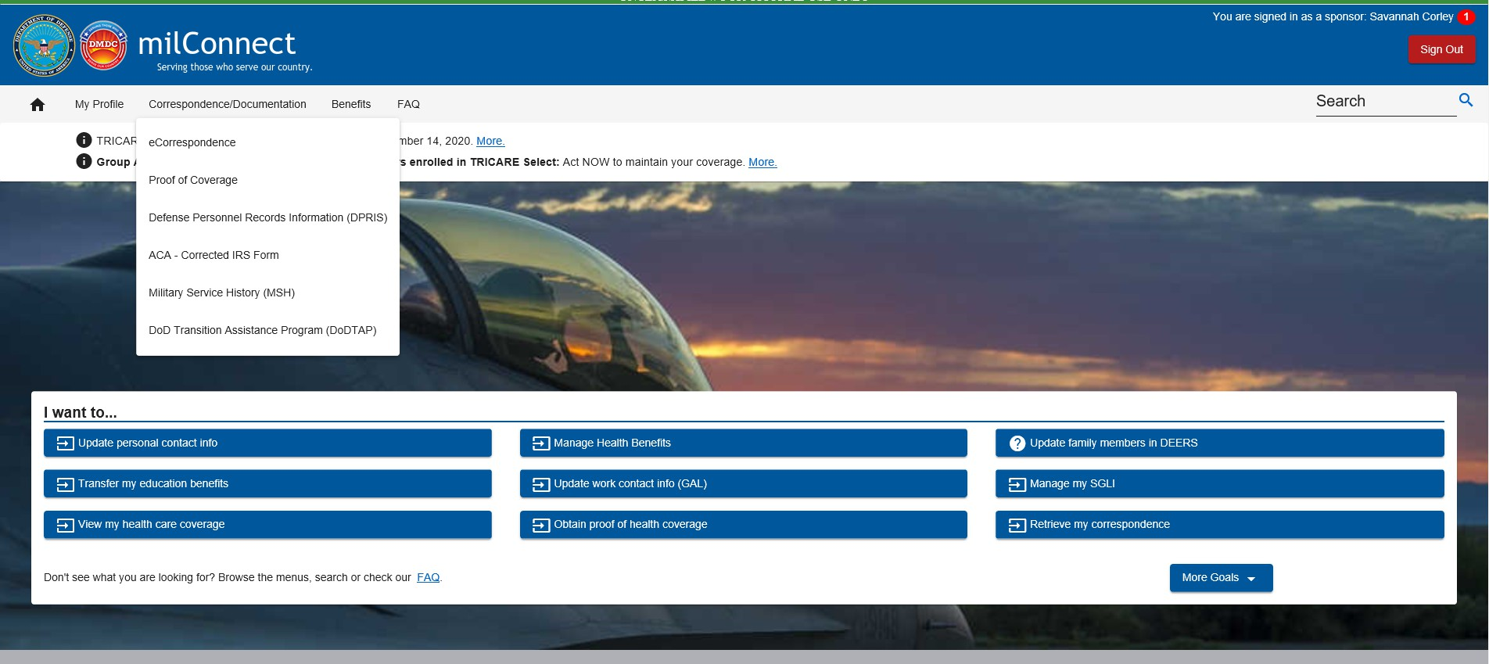
milConnect
Next, select “Defense Personnel Records Information (DPRIS)” from the dropdown menu.
I n t e g r i t y - S e r v i c e - E x c e l l e n c e

Slide 6
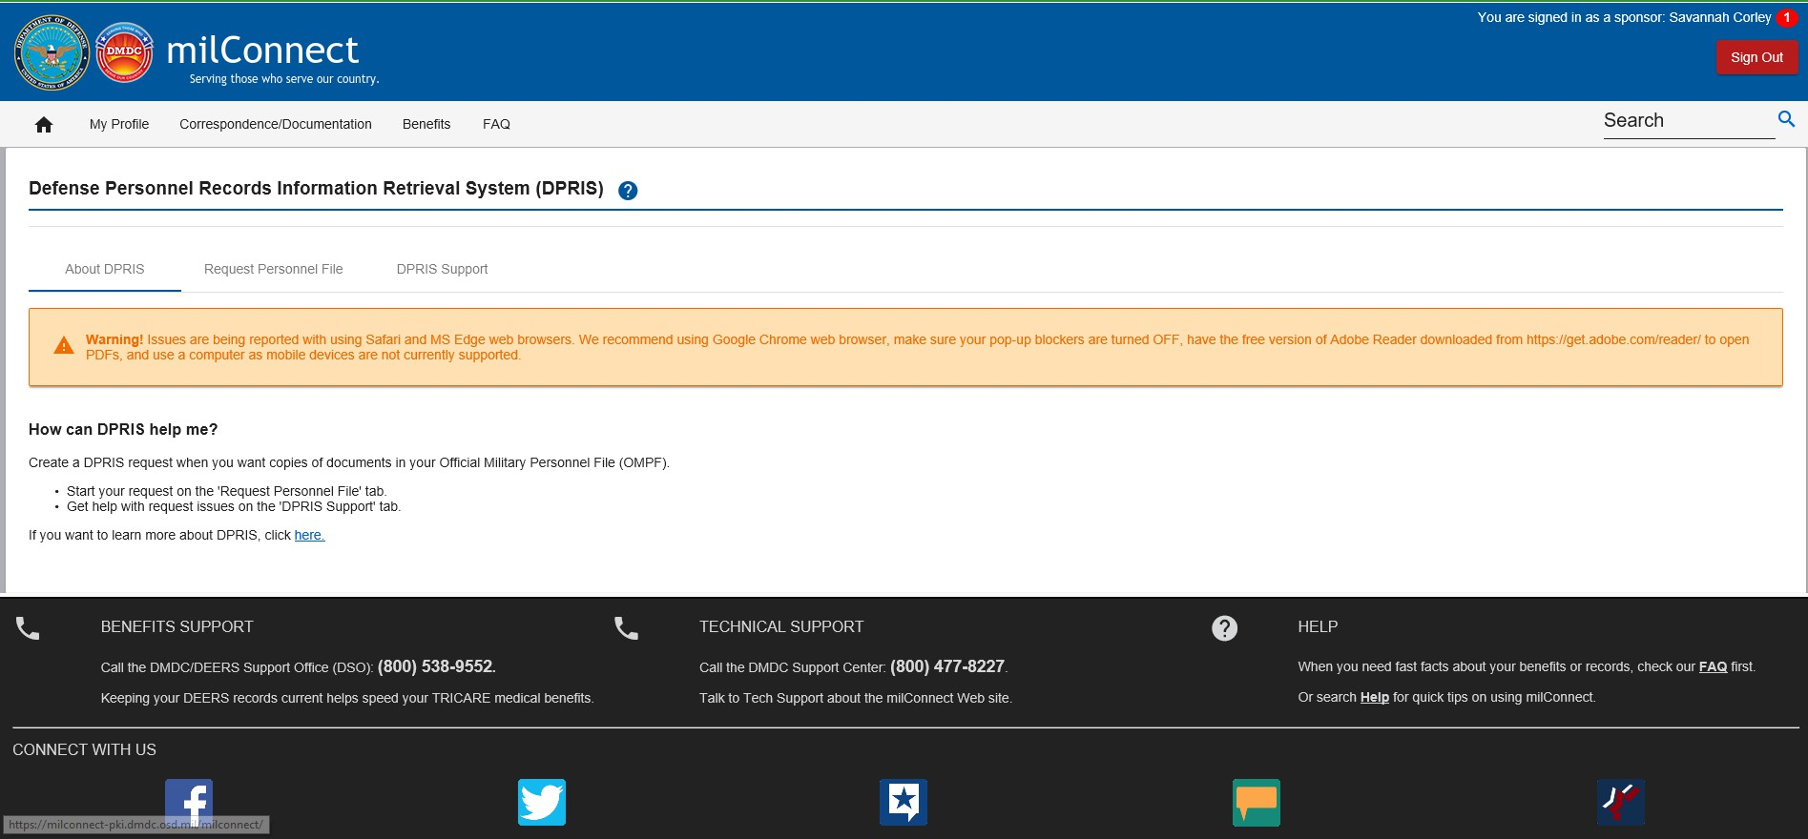
milConnect
Click on “Request Personnel File”
I n t e g r i t y - S e r v i c e - E x c e l l e n c e

Slide 7
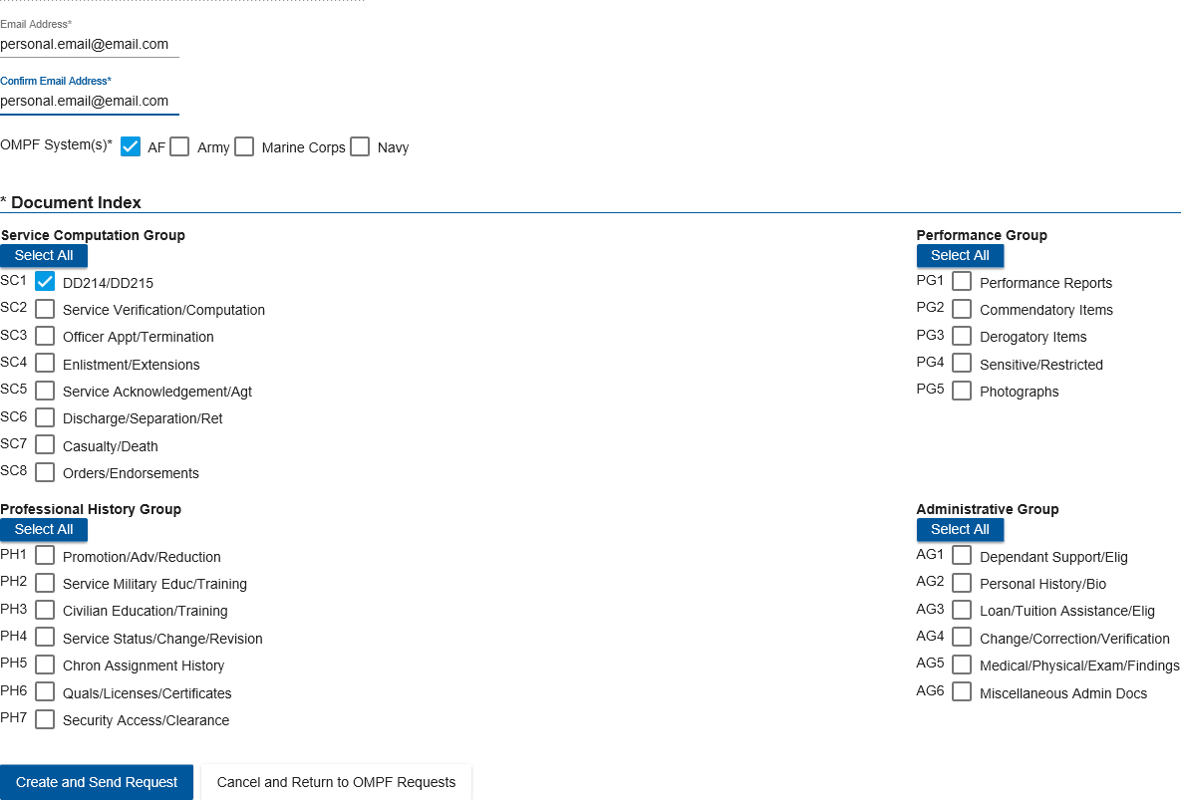
milConnect
Select “Request my Personnel File”
Fill in all applicable info:
*Email/Confirm Email (personal email)
*OMPF System = AF
*Required documents (all that apply)
Click “Create and Send Request” when all selections made
I n t e g r i t y - S e r v i c e - E x c e l l e n c e

Slide 8
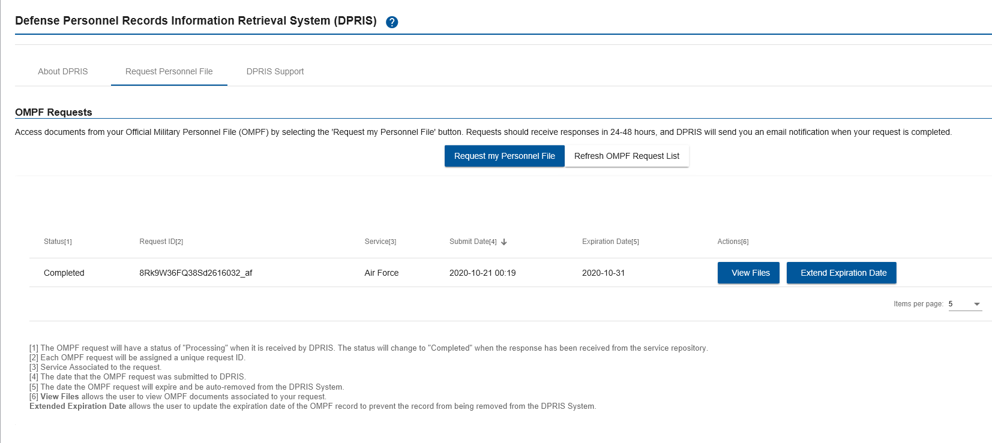
milConnect
You will be redirected to the OMPF Requests page.
When the status states “Processing” you request has been received by DPRIS.
Requests should receive responses in 24-48 hours and member will receive an email notification from:
dodhra.dodc-mb.dmdc.mbx.dpris-helpdesk@mail.mil
When request is complete member will be able to access requested records via milConnect by navigating back to the DPRIS OMPF Requests page:
View Files
Completed
I n t e g r i t y - S e r v i c e - E x c e l l e n c e

Slide 9
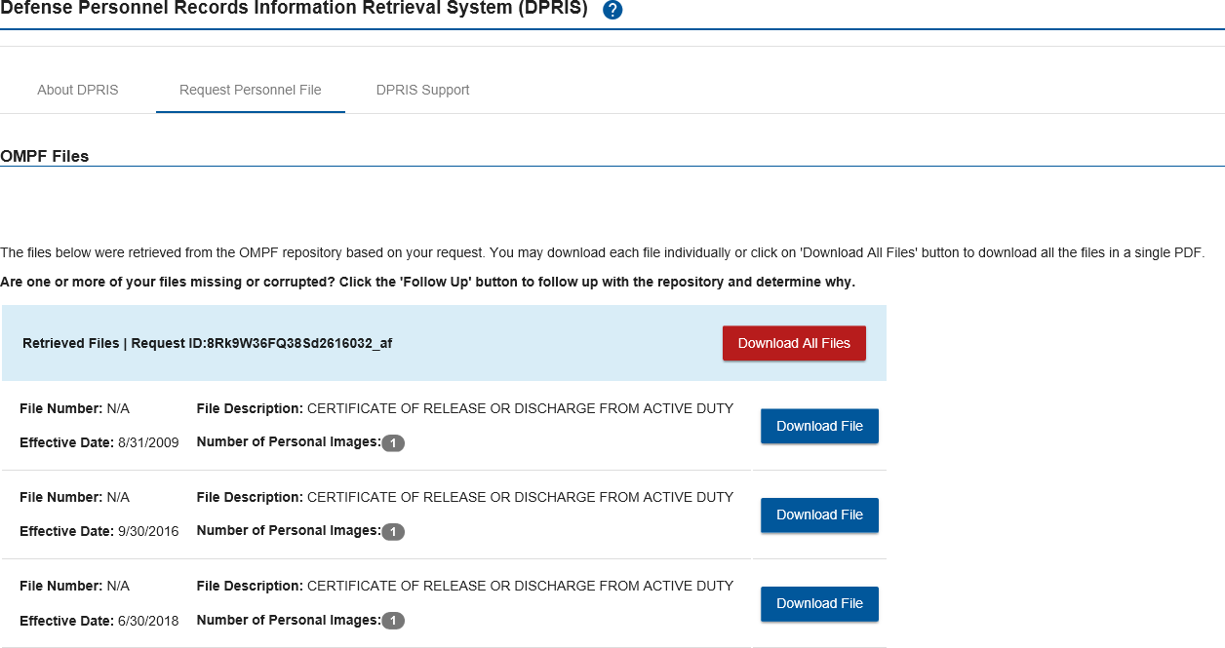
milConnect
Select “View Files”
You can download each file individually or click “Download All Files” to download all files in a single PDF
I n t e g r i t y - S e r v i c e - E x c e l l e n c e

Slide 10
milConnect
As long as your record has been scanned and uploaded to your Official Military Personnel File (OMPF) you will be able to request your records via DPRIS in milConnect.
If you have any issues or need any assistance please contact ARPC/AFPC by calling 1 (800) 525-0102
THANK YOU FOR YOUR SERVICE!
Portland Air National Guard Base FSS – (503) 335-4046
I n t e g r i t y - S e r v i c e - E x c e l l e n c e

